Slide 1
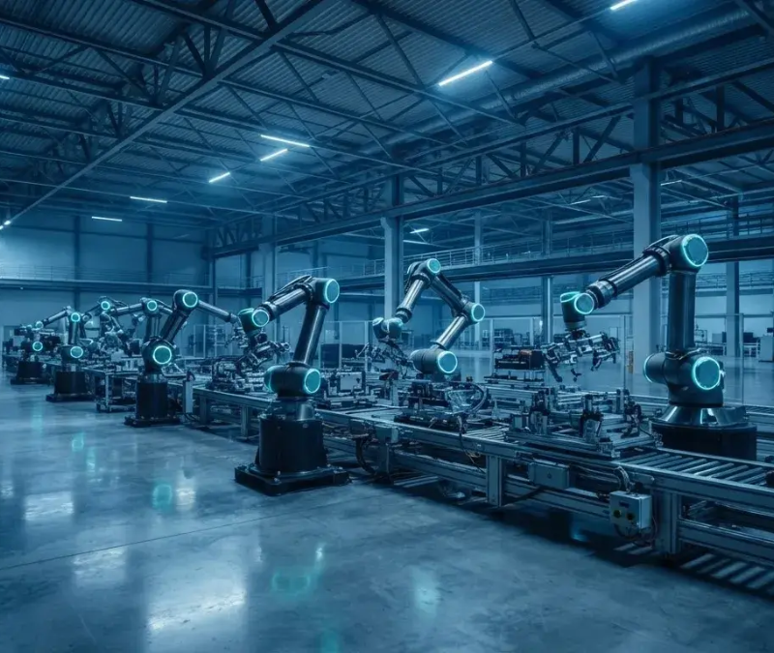
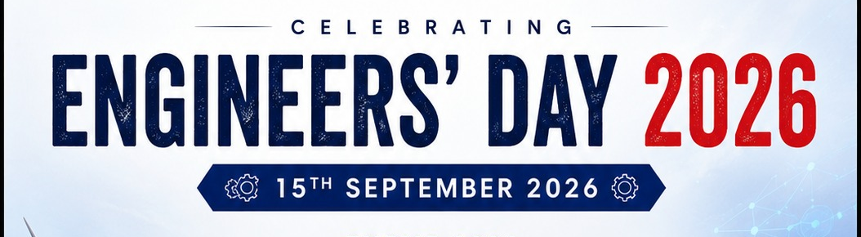


Industry 4.0
“What if a machine could predict its own failure?”
INDUSTRY 4.0: FROM SMART
MACHINES TO SMART
FACTORIES
Engineering the Future of
Intelligent Manufacturing
Gulshan Kumar
Mechanical Engineering
Under the Guidance of:
Mr. Atul Jyoti
Sr. Lecturer, Department of Mechanical Engineering
Under
STATE BOARD OF TECHNICAL EDUCATION
PATNA (BIHAR)
1/9

Slide 2


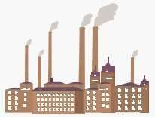
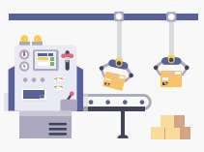
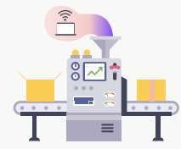

Industrial Revolution
1760-1840
1871-1914
1960 - 1990
2011 - Present
INDUSTRY 1.0
Mechanization
Steam & water power
INDUSTRY 3.0
Automation
Computers & programmable controllers
INDUSTRY 4.0
Smart Manufacturing
IoT, AI, Cloud & Cyber-Physical Systems.
INDUSTRY 2.0
Mass Production
Electricity & assembly lines
2/9

Slide 3








Industry 4.0 Technologies
Industrial Internet of Things
Robotics
Big Data
Digital Twins &
Simulations
INDUSTRY 4.0 TECHNOLOGIES
Artificial Intelligence
Cyber Security
Machine
Learning
3/9

Slide 4
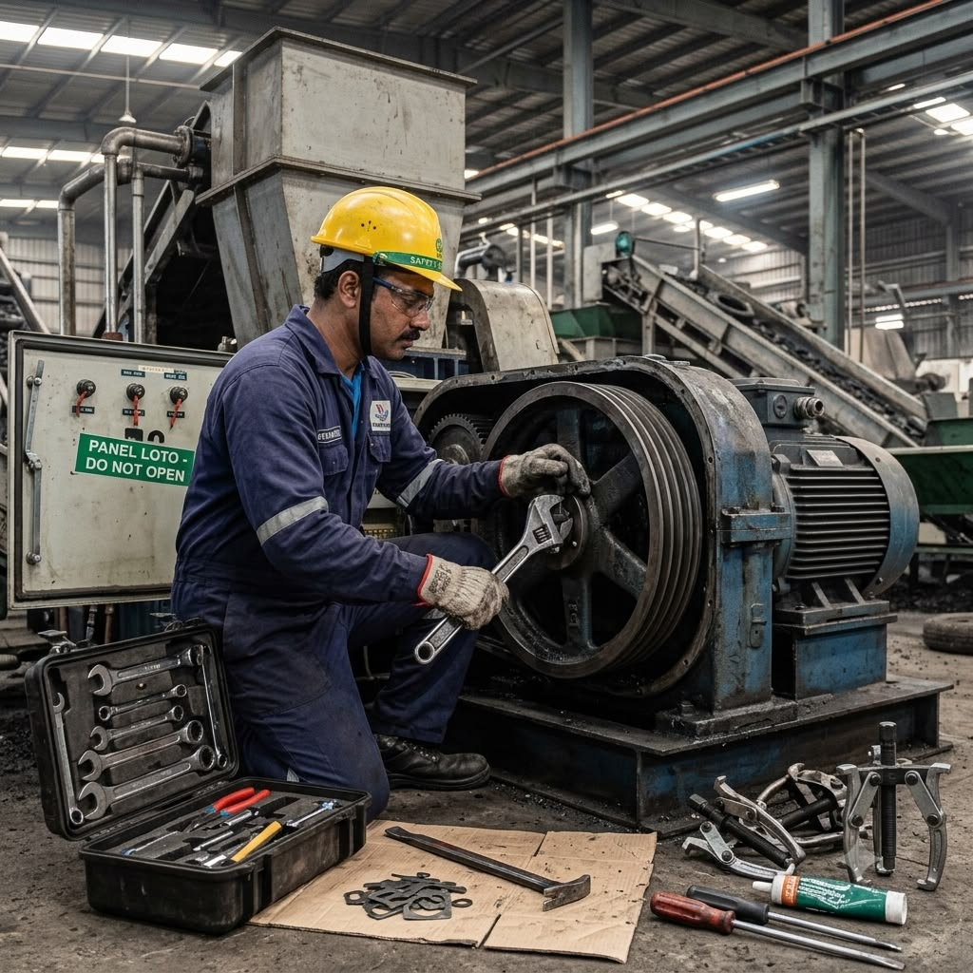
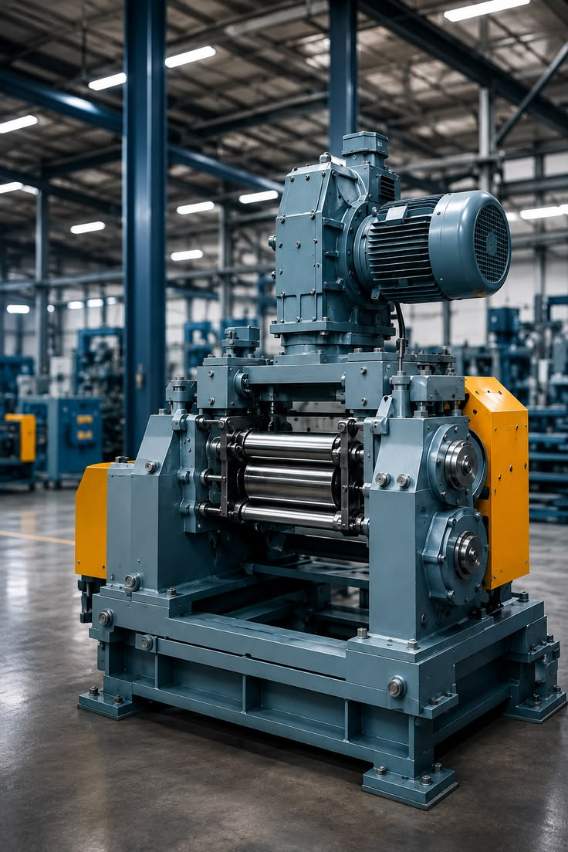
CAN A MACHINE PREDICT ITS OWN
FAILURE?
Planned
Maintenance
Early Warning
AI Platform
IoT Gateway
Sensor Data
AC
Induction
Motor
Vibration | Temperature | Pressure
4/9
Image source: Pinterest

Slide 5
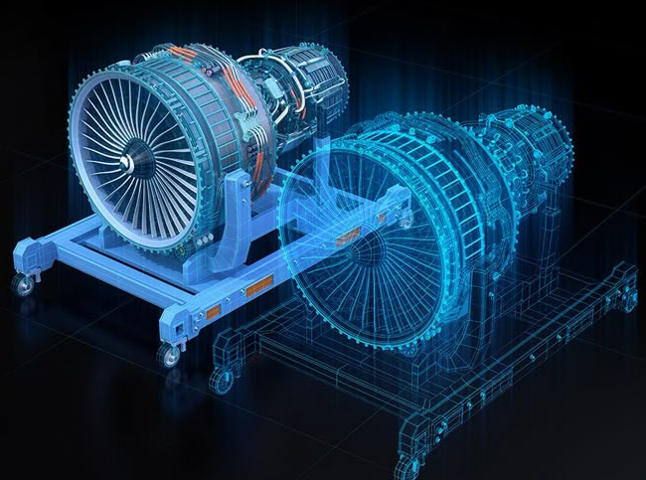
“Build and test virtually before changing the physical machine”
THE DIGITAL TWIN
Monitor Real-time Status
Simulate Test Scenarios
Optimize Performance
Image source: Pinterest
5/9

Slide 6
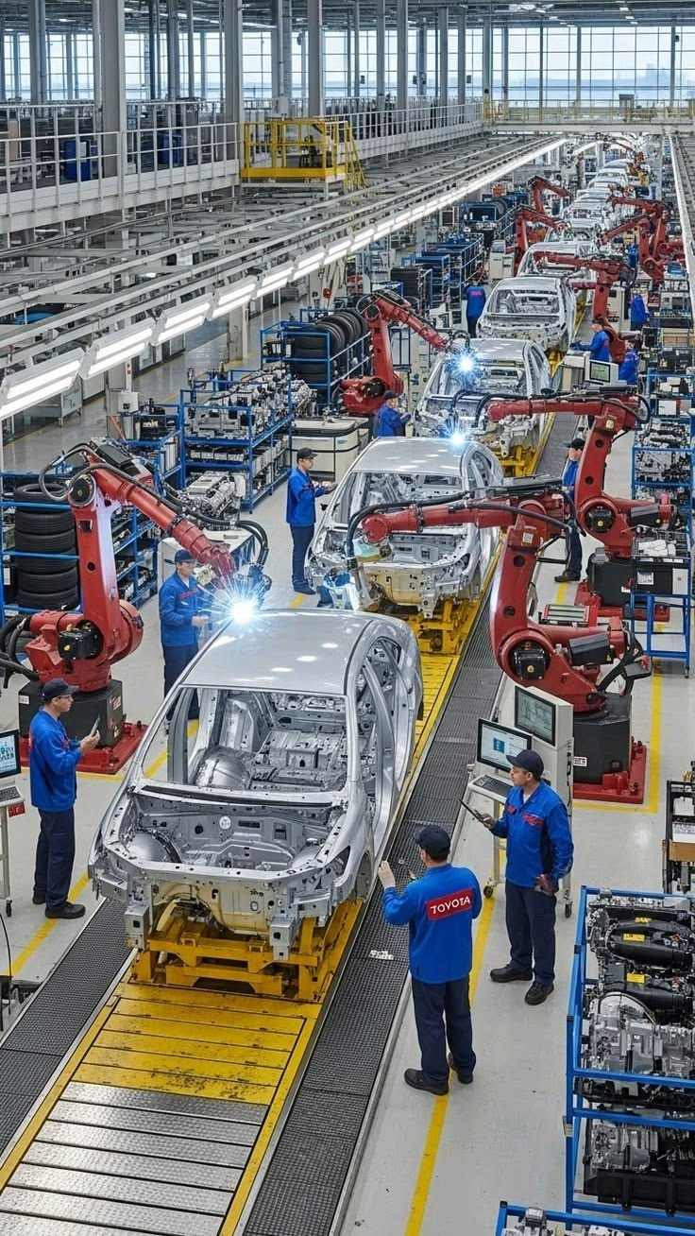
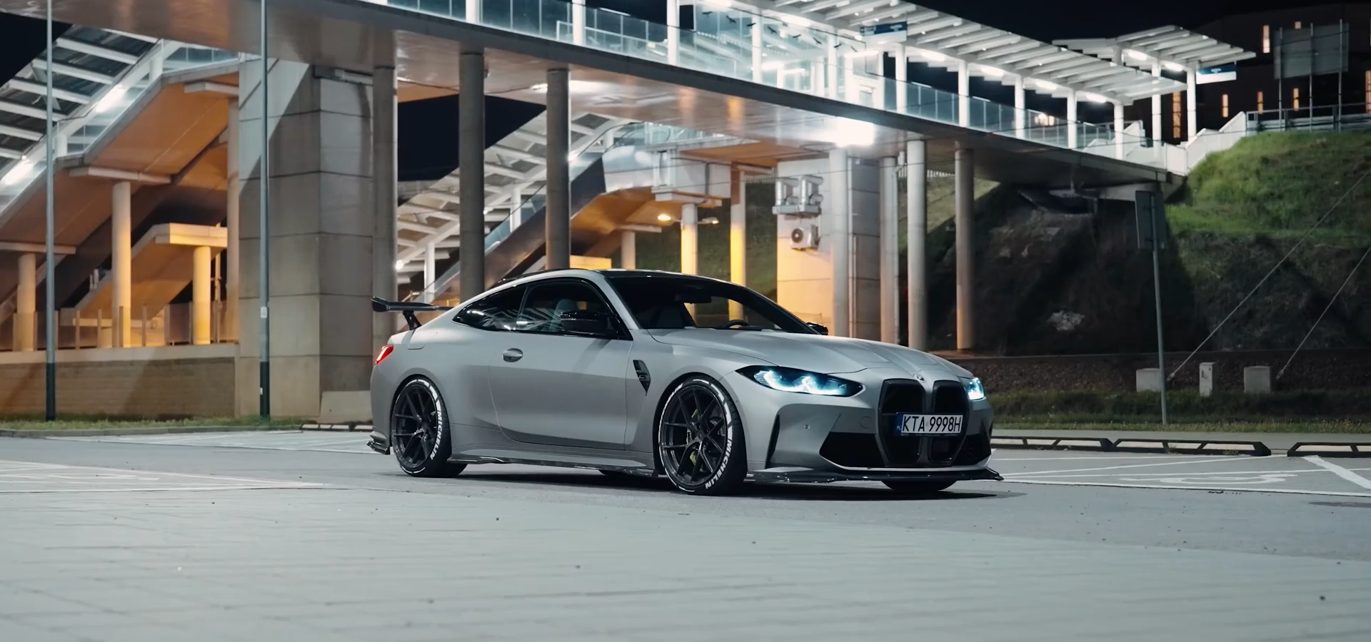
.
BMW iFACTORY
Industry 4.0 is already transforming global manufacturing
AI & Virtual
Factory
Digital Process
Optimization
Autonomous
Logistics
Digital Twin
Integration
6/9
Source - Pinterest, Youtube

Slide 7
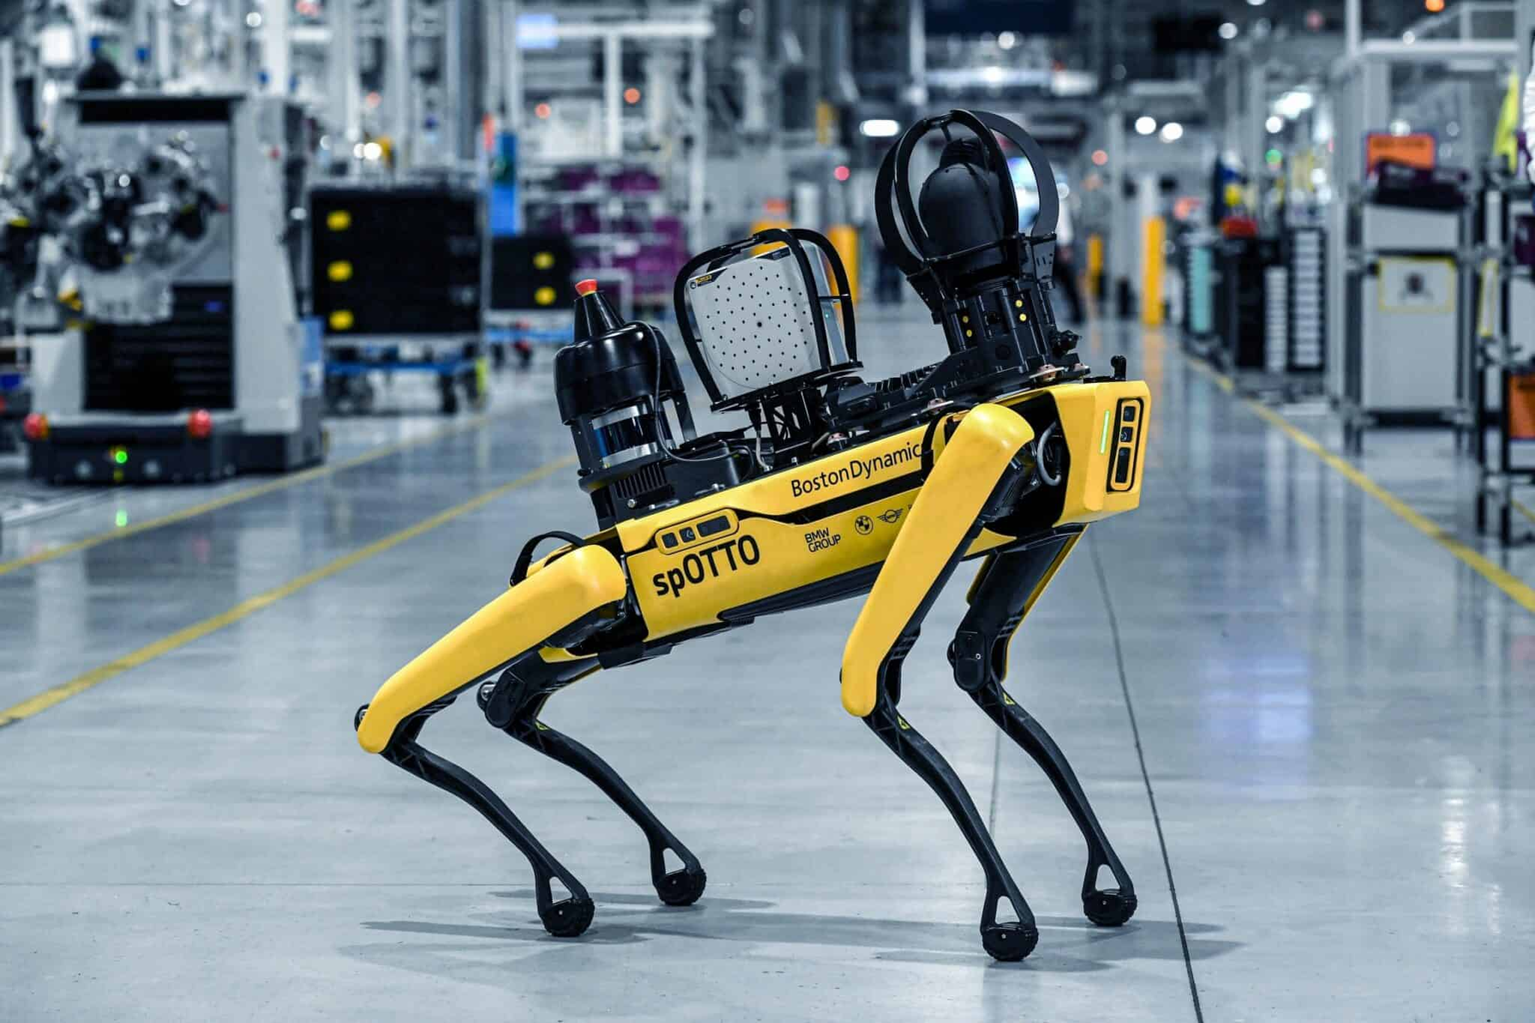
ROBOTIC INSPECTION
Innovation: BMW SpOTTO at
Hams Hall
Manual
Autonomous
Real-time
Digital Twin
Predictive
Inspection
Data Collection
Maintenance
Synchroniza-
Maintenance
Human-performed,
Robots gather visual,
Sensing
tion
Proactive repairs,
time-consuming
thermal, acoustic
Robots detect
Data updates a
reduced downtime
data
potential issues
virtual factory model
instantly
7/9
Reference - BMW Group PressClub — “Good boy, SpOTTO”, 2024

Slide 8
WHAT DOES IT DELIVER?
Measurable engineering
value across the entire
production cycle
Enhance Productivity
Increase output and efficiency
Promote
Sustainability
Optimize Maintenance
Implement eco-friendly
Reduce downtime and costs
practices
Reduce Energy
Improve Quality
Consumption
Ensure high product
Lower environmental impact
standards
Increase Flexibility
Adapt to changing demands
8/9

Slide 9
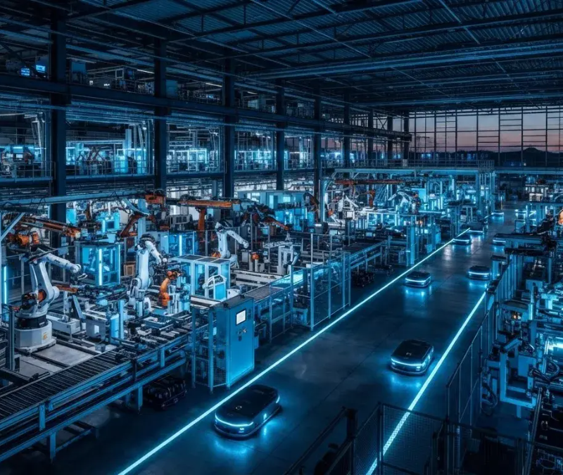
Conclusion
THE FACTORY OF TOMORROW
It won’t just produce.
It will think.
learn, and adapt.
🙂
THANK YOU
Any Questions?
Engineering the Future Starts
With Us
9/9
Image source: Pinterest

